Slide 1
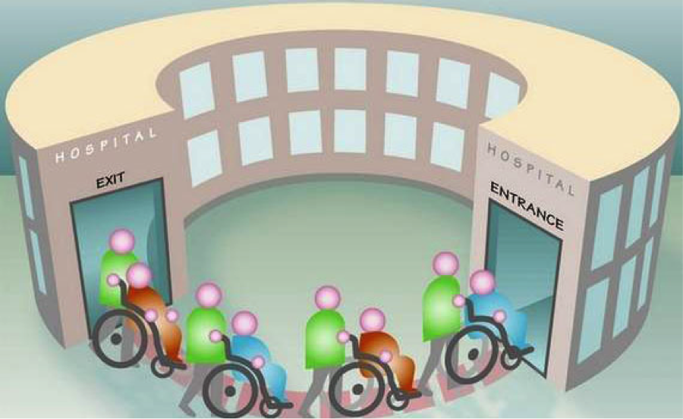
Hospital Readmission Reduction Application
Team 5:
Dipti Pamnani
Jayesh Samyani
Suraj Sharma
Under Guidance of:
- Prof. Sri Krishnamurthy
- Ashwin Dinoriya

Slide 2

Problem Statement
There has been an alarmingly high risk of readmission in the US.
Hospital readmissions are expensive and reflect the inadequacies in healthcare system.
Early identification of patients facing a high risk of readmission can enable healthcare providers to conduct additional investigations and possibly prevent future readmissions.
This not only improves the quality of care but also reduces the medical expenses on readmission.
Lot of cost is penalized on hospitals due to increased readmissions.

Slide 3
Solution
We seek to predict whether a patient discharged from hospital will be readmitted in the future.
We can also estimate the penalty, which is imposed on hospitals if they have more readmission than certain threshold.
We cluster the patients on various parameters like number of lab procedures, number of diagnoses, number of inpatient visits, number of medications and age.

Slide 4
Implementation
The readmission class prediction is achieved using the following models in Azure Machine Learning
Logistic Regression
Neural Network
Random Forest
Two Class Boosted Decision Tree
Our application chooses the best algorithm based on maximum scored probabilities
Our application supports real time and batch prediction inputs

Slide 5
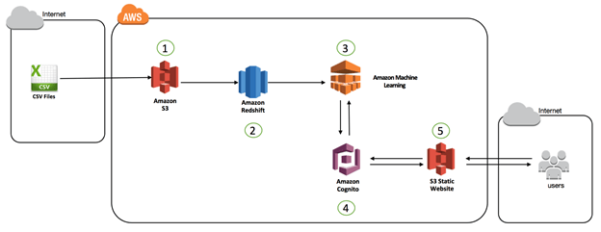
Amazon Machine Learning

Slide 6
Demo

Slide 7
Q & A

